Slide 1
RANKING ALGORITHM
TEAM CCIBT9
HIGH LEVEL DESIGN DOCUMENT

Slide 2
Team Details
Name | Domain
Susmitha Priya Maddula | Frontend
Simran Kaur Lamba | Frontend
Tirth Jain | Backend
Gaurav Singh Choudhary | Backend & Frontend
Sachin Raghul T | Backend & Frontend
Dhruv Sharma | Backend & Frontend
Yashaswini | ML
Bhanu Prakash Pebbeti | ML
Joy Purohit | ML
Srijarko Roy | ML
Vidhi Jain | ML

Slide 3
Problem Statement
Resolve the document ranking challenge which is inefficient and laborious, thus helping streamline business processes.

Slide 4
Objectives
To come up with a simplified application which consists of an RIA User Experience and an ML algorithm to generate a more efficient ranking.
Assigning grades based on skill match relative to the job description
Ranking based on various parameters
Identification of the duplicate document with a certain similarity threshold and configurable duration
The ability to generate reports with custom filters
Search engine to display details based on criteria provided

Slide 5
Assumptions
Ranking based on domain is limited to a specific set of domains.
Reports to be generated are assumed to be statistical reports with custom filters.
Ranking based on job switches is assumed to be a hand-coded rule with some assumed threshold value.
Ranking based on organisation and institution is assumed to be derived from some particular rankings found on the web.

Slide 6
Problem Analysis
With emerging job opportunities and tonnes of job applications, there is a need of automating the resume ranking process.
Finding suitable candidates for an open role could be a daunting task, especially when there are many applicants. It can impede team progress for getting the right person at the right time.
An automated way of “Resume Classification and Matching” could really ease the tedious process of fair screening and shortlisting, it would certainly expedite the candidate selection and decision making process.
The main objective of this project is to create an application which is capable of ranking the resumes uploaded by users.
The user Interface should provide users the option of being a job searcher and job recruiter. The main ranking algorithm running at backend is an AI-based model capable enough to extract features, patterns from resumes and assign them a rank based on the criteria provided by the recruiter.

Slide 7
Proposed Working Phases:
Phase-I : Named Entity Recognition
Extracts entities from both resume and job description.
Phase-II : Ranking Based on Criteria
Recommend the resume according to the ranks assigned to individual resumes based on the user chosen criteria

Slide 8
Use case
Actors:
User
Job searcher
Job recruiter
Use cases:
User registration
User login
Create Profile
Uploading the resume
Creating the job application
Applying for the job application
View the applied jobs
View the applied candidates list
Sorted list based on resume ranking

Slide 9
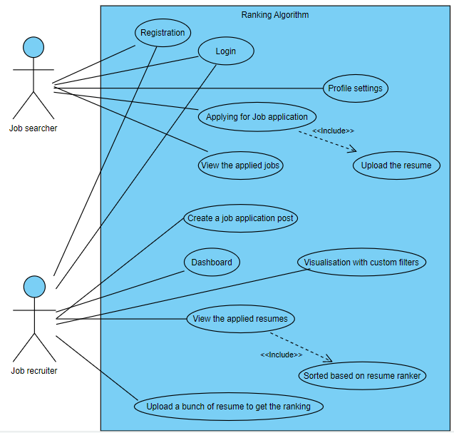
Use Case Diagram

Slide 10
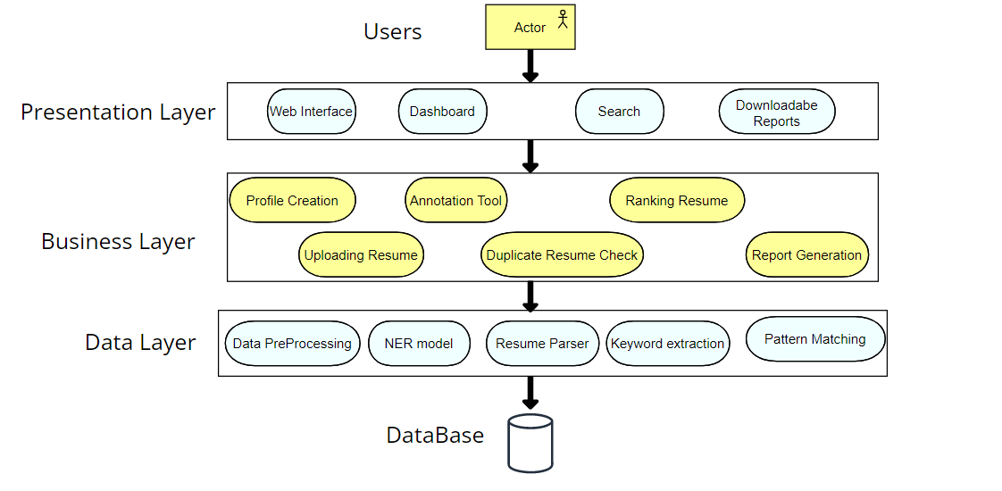
Architecture Diagram

Slide 11
Tools and Technologies
Machine Learning | Python and its libraries PyTorch spacy nltk Hugging Face pdfminer/docx2txt
Frontend | React Redux
Backend | Express Node
Database | Mongodb
Collaboration tools | Github Notion board Google docs

Slide 12
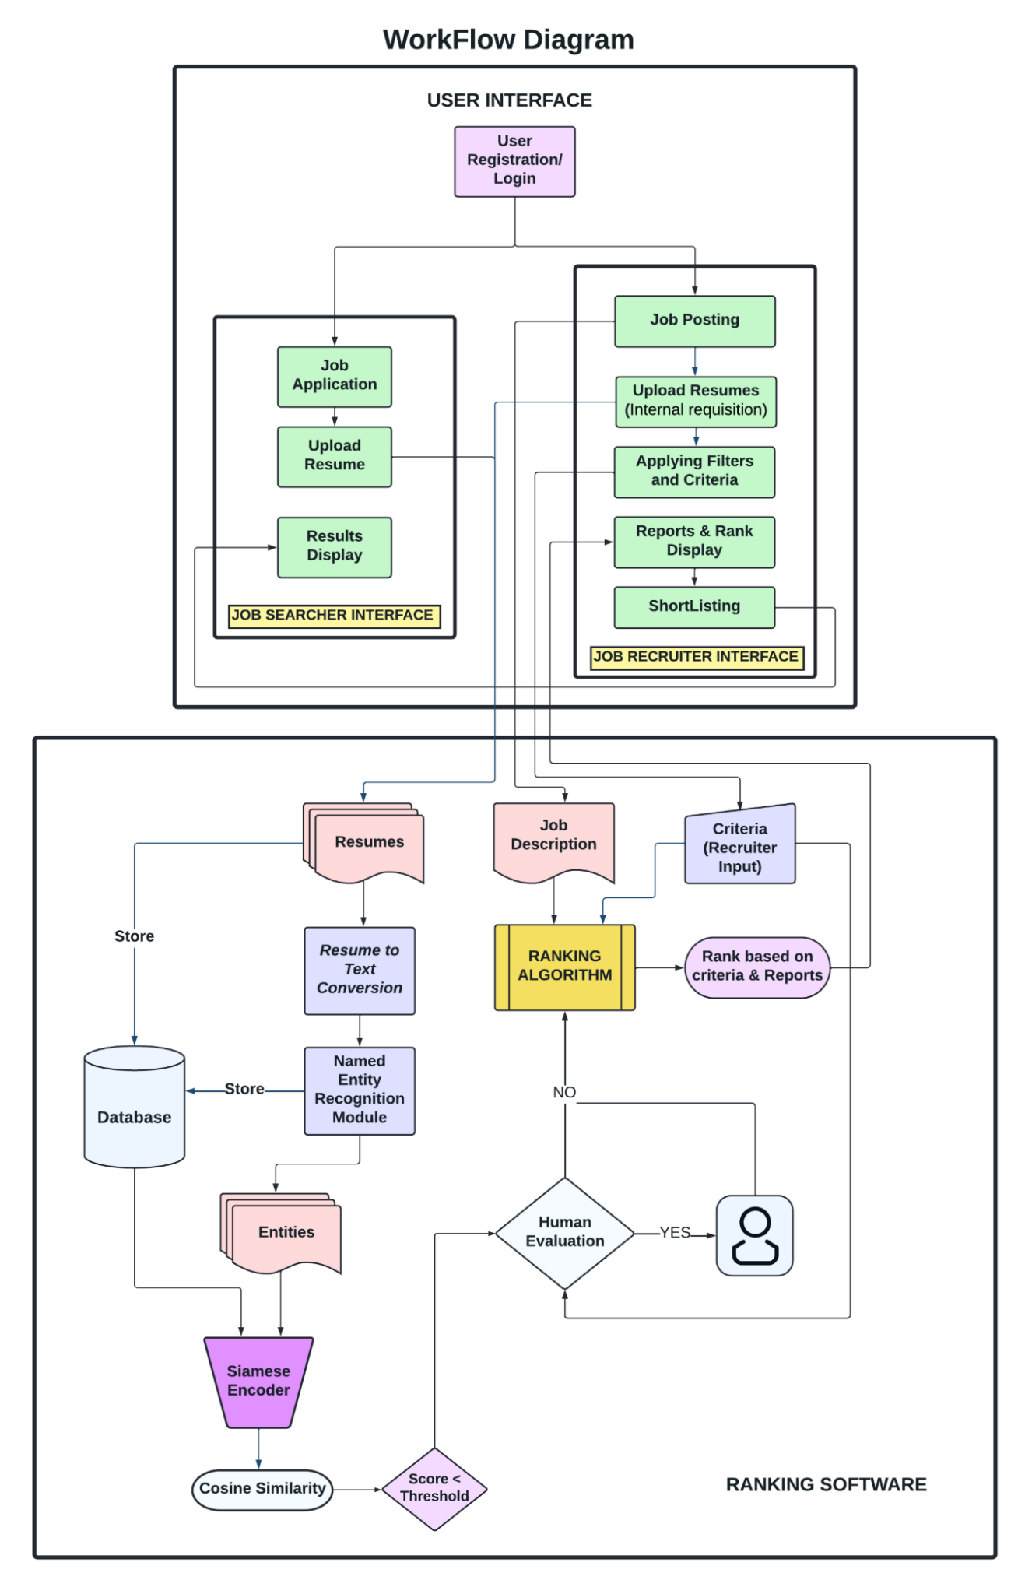
Workflow

Slide 13
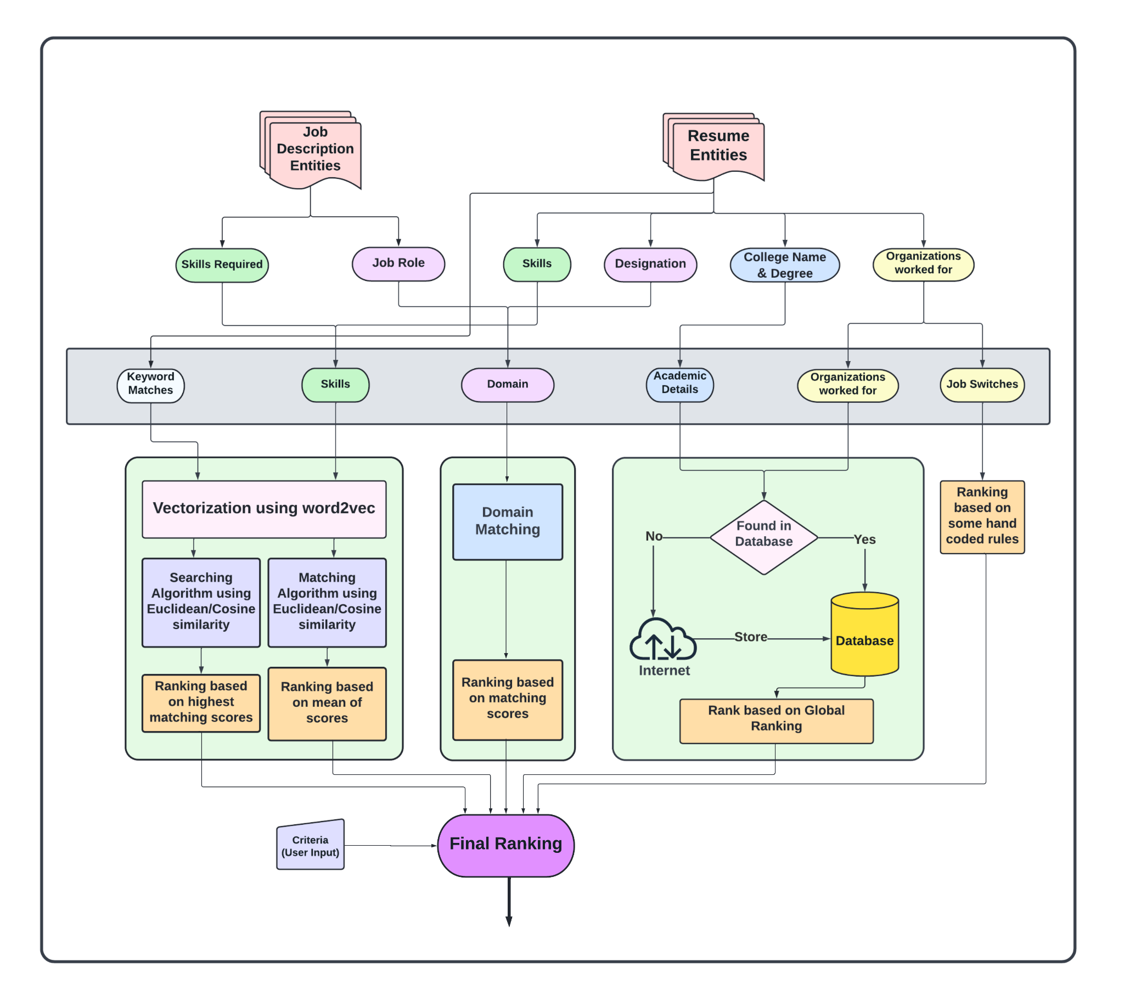

Slide 14
Backend Database
USER
Email | String
password | optional<hash>
type | enum{ searcher, recruiter }
SEARCHER
user | User
name | string
phone | number
applications | application[]
bookmarks | Post[]

Slide 15
RECRUITER
user | User
name | string
jobs_created | Post[]
POST
user | userId
description | string
domain | string
image | imageURl
applications | application[]
deadline | time
job-type | enum<>
email | string

Slide 16
APPLICATION
user | userId
post | postId
resume | resumeId[]
RESUME
url | string

Slide 17


Testing Tools
Jest : - For unit testing
Cypress :- For end-to-end testing

Slide 18
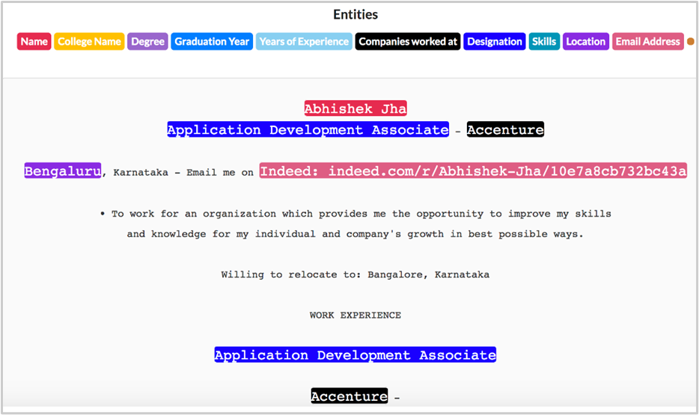
Datasets
NER Dataset

Slide 19
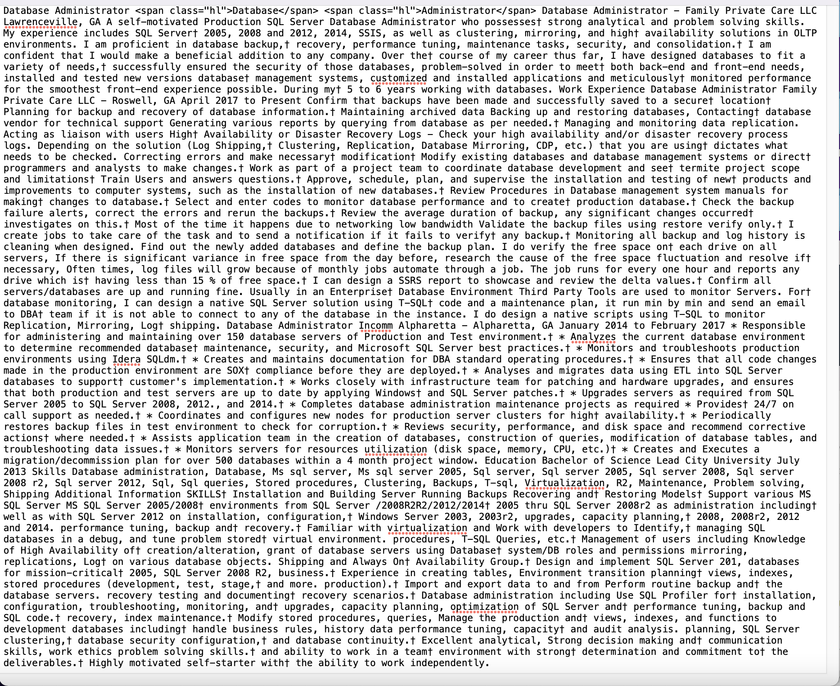
Datasets
RESUME CORPUS
(https://github.com/florex/resume_corpus)
It has text files for every applicant
which include: Experience, Education
and Skills.

Slide 20
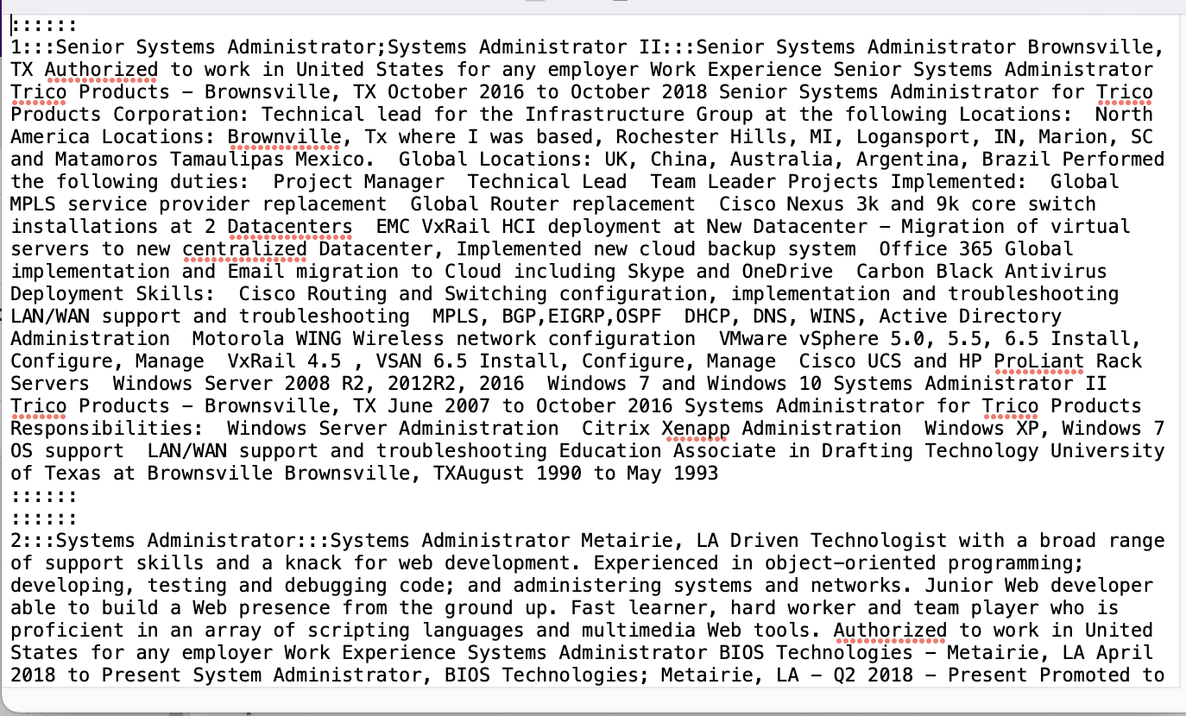
It also has the Job Description and Job Skills for each domain for comparison with applicant designation and skills.

Slide 21




References
MaterialUI
Bootstrap
PyTorch
torchtext
Hugging Face

Slide 22
Thank you

